Slide 1
HOW TO MOVE YOUR MBOT ?

Slide 2
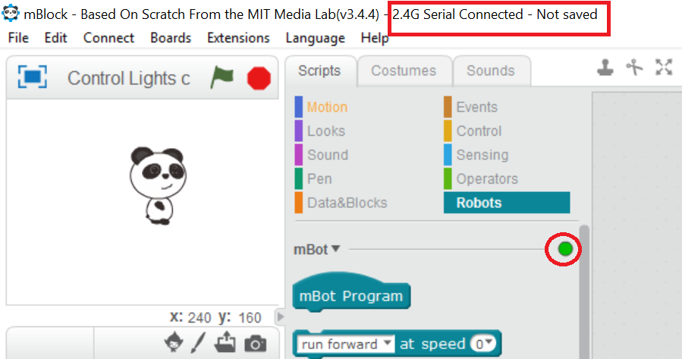
STEP 1.a: Connect your mBot in 2.4G serial mode
Start the mBlock application on your laptop
Select Connect > 2.4G Serial > Connect
The top of the window should look like this !

Slide 3

STEP 2a Move your mBot
To move your mBot you can use “run forward at speed 0”
Change the speed from 0 to 100
Your program should look like this !
Now, press the green flag !

Slide 4
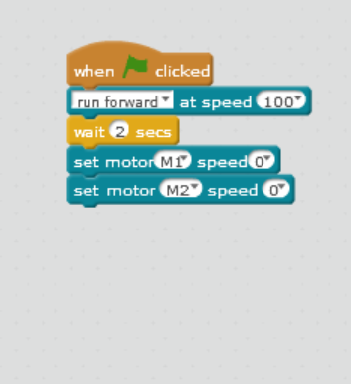
STEP 2a Is your mBot running endlessly ?
Ok. Catch your mbot.
Now, add the “wait” and “set motor M1 speed at 0”
Your code should look like this !
Note: Don’t forget to change the motor m1 to m2 in the second “set motor” command

Slide 5
STEP 3 Try doing it !!
Now, try to move the mBot backward and sideways by changing the direction in the “run forwards” command

